Slide 1
Mobile Internet
Виконав:
студент ІІІ курсу
групи ІО-12
Бута Сергій

Slide 2
1. INTRODUCTION
Two concepts
Internet
Mobile
Internet – short history (fixed networks)
1969 – ARPA
Noncommercial apps
and
Weak development (1970-1990)
Exponential grows after beginning of 90-th (some figures)
Plans for NGN

Slide 3
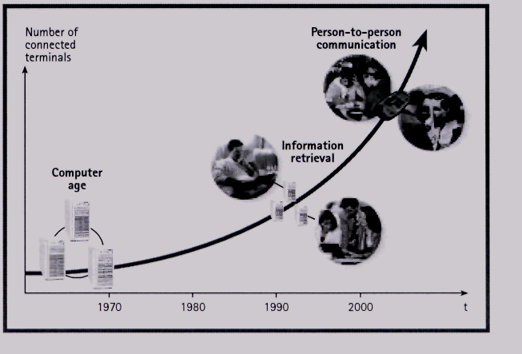
Internet development’s illustration

Slide 4
Mobile – short history
70-th – first mobile networks (analog) – 1G
90-th – digital mobile networks – (2G, GSM)
Beginning of current decade – (2,5G, EGSM)
Expectations – 3G (broadband access, HBRs in air interface)
Exponential grows (some figures)

Slide 5
Constant time-lag between fixed and mobile network applications
Functionality
3 - 5 Years
Audio & Video
broadband (DSL,
CATV, etc.)
Fixed networks are leading
Audio & Video
broadband
(UMTS)
Functionality
Speed
Cost
Audio & Video
narrowband
Audio & Video
narrowband
(GPRS)
Pictures
Graphics
WWW
Pictures
Graphics
HSCSD
WAP
Text
SMS
1991
1994
1997
2000
2003
Year
Start of the World Wide Web

Slide 6

Penetration rates for different services (for the US market)
Time to reach 50 mln customers
120
100
80
60
40
20
0
TV
(15 years)
millions of customers
Telephone
(90 years)
Internet
(<5 years)
Cable TV
(10 years)
Radio
(40 years)
Computer
Mobile Phone
1922
1950
1980
1995
Products have an accelerated market penetration.

Slide 7






2. Key forces for broadband access
Public Network Principles
Wireless
Technologies
Optical Fiber
Twisted Pair
Backbone Network
Cable/Coax
Power line
Access Gateway
Network Terminations
Switching
Transmission
Access Network
Transmission

Slide 8
How long does it take to download
Wireless
wired
Byte
3 k (EM)
3 M (S/HRP)
300 M (1hV)
bit/s
GSM
9,6 k
2,5
secs
42
mins
3
days
PSTN
56 k
0,4
secs
7
mins
12
hours
GPRS
ISDN
115 k
128 k
0,2
secs
3,5
mins
6
hours
Live Video codecs starting with 32 kbit/s
UMTS
ADSL
2 M
8 M
0,01
secs
12
secs
20
mins
Cable
WLAN
30 M
80 M
1
msec
1
sec
30
secs
Fiber
800 G
30
30
µsecs
3
msecs
nsecs
Notes:
10

Slide 9
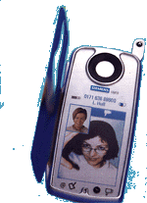
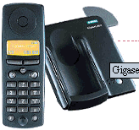
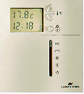
Broadband to the customer via different techniques
Two
general types
to access
the informational
Resources
through Net
Satellites
Sky Stations
GSM/GPRS/UMTS
WLAN
Optical fiber
Twisted Pair
xDSL/ Cable/Coax
Access Network
Backbone Networks
Notes:
15

Slide 10
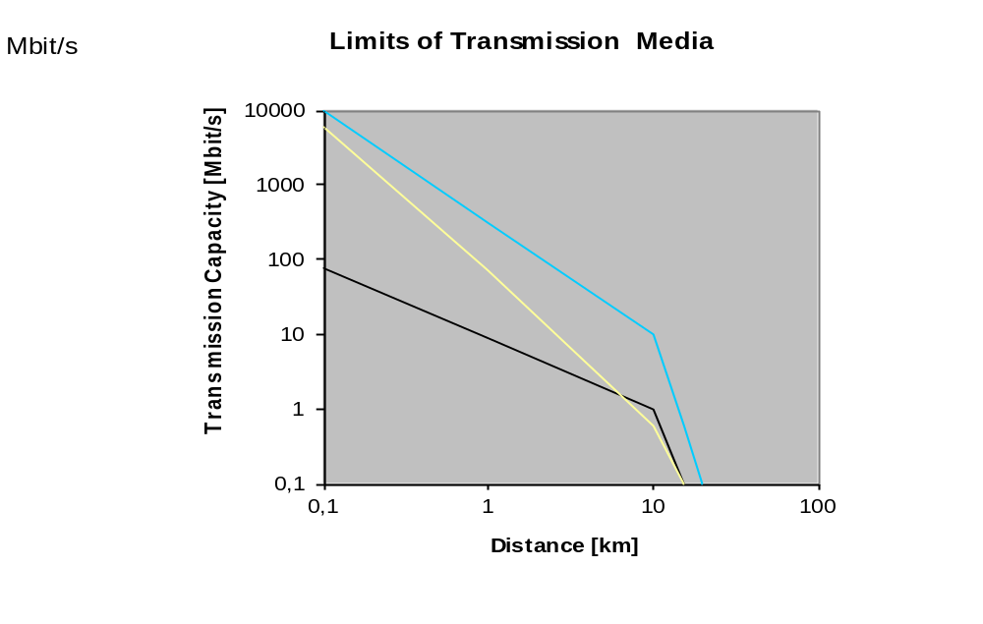
Technological limitations of different transmission media
Fiber
250
Cellular
Wireless*
Coax
Copper Twisted Pair
*Capacity in Mbit/s/sqkm

Slide 11
3G - UMTS
EDGE
GPRS
HSCSD
CDMA
GSM
AMPS
PCS
VSAT
WLAN
PMP
CDMA
DECT
TV
Bluetooth
Cellular
WLL
Satellite
Wireless access technologies

Slide 12
Networks go broadband
Satellite 1.2G
1G
100M
10M
1M
100K
10K
1K
Satellite
40M
250 Mbs
office
(Indoor)156M
MMAC
Cable
modem
(Outdoor)30M
human
perception
xDSL
home
UMTS
ISDN
GPRS
128K
Analog modem
56K
33.6K
Transmission Rate (b/s)
Plan
in Operation
Source: SRI International
9.6K
1980 1985 1990 1995 2000 2005 2010 2015 2020
Year
Notes:
7

Slide 13
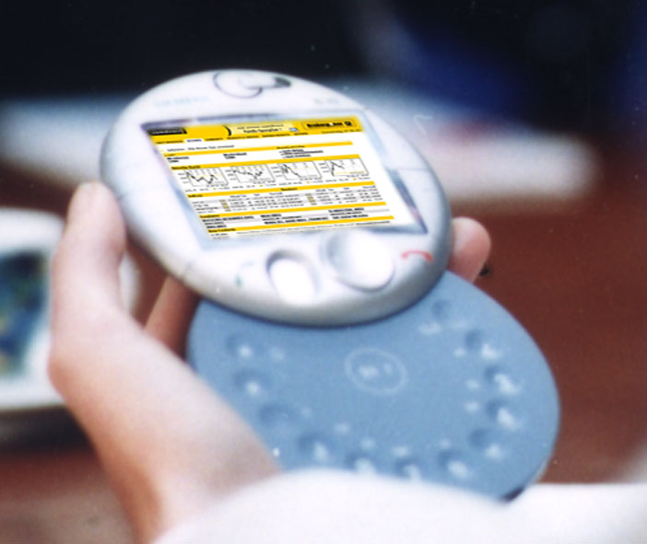

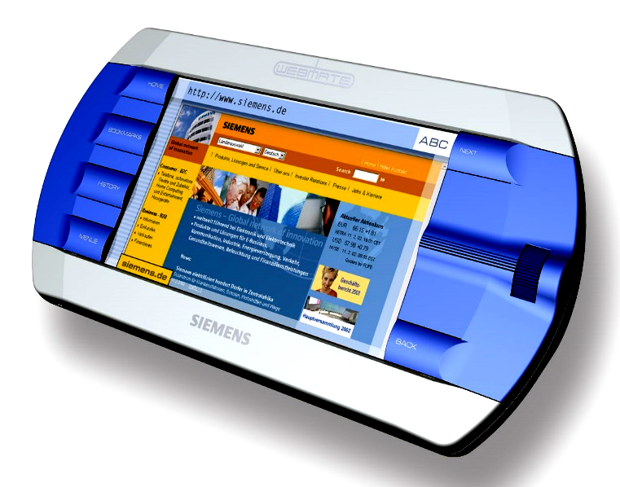
Mobile access will dominate
Subscriptions worldwide (millions)
1800
1600
Mobile
Fixed
Mobile Internet
Fixed Internet
Mobile
subscriptions
1400
1200
1000
Mobile Internet
subscriptions
800
600
400
200
0
1995
2000
2005
2010
Source: Siemens
Notes:
27

Slide 14
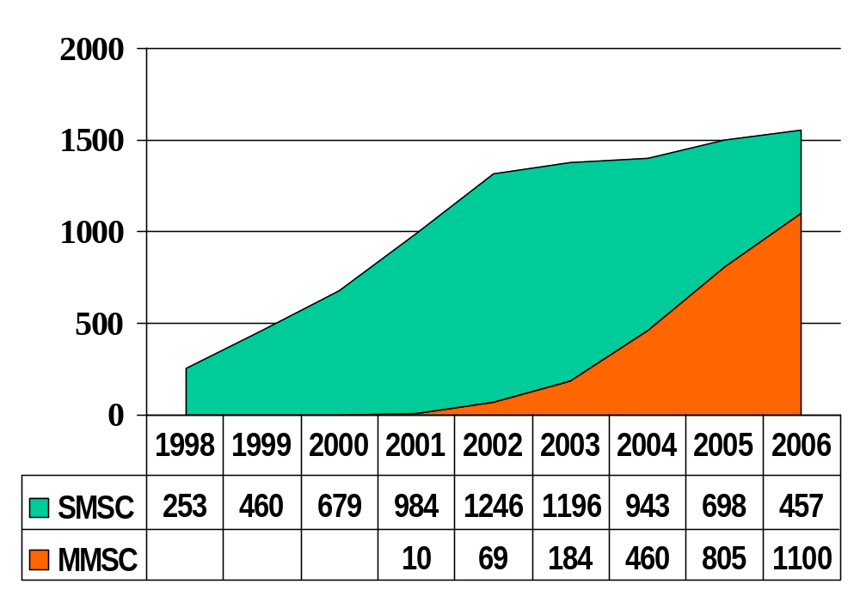
Mobile Messaging Market
SMSC/MMSC Supplier Revenues [€m], worldwide
SMSC:
Short Messaging
Service Center
MMSC:
Multimedia Messaging
Service Center
Source: UBS Warburg, 01/02
Notes:
36

Slide 15
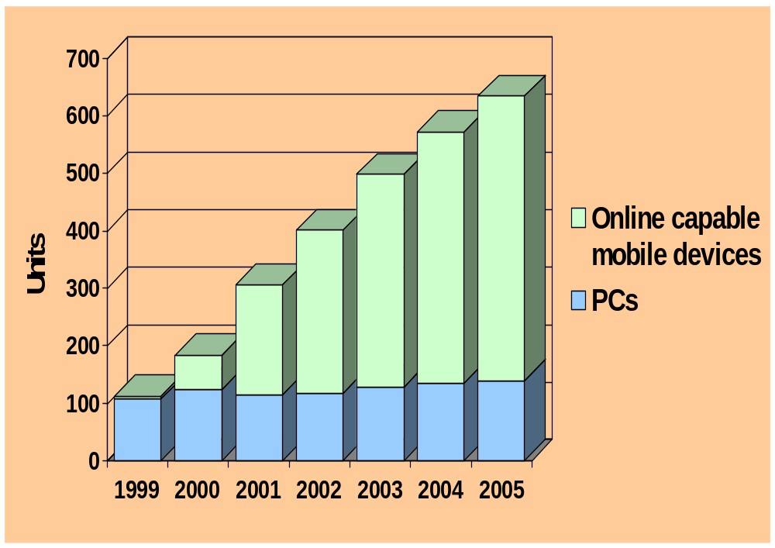
Mobile Devices’ Market
Source: Dataquest and UBS Warburg
Notes:
15

Slide 16
Mobile and Internet Penetration
in Western European Countries (YE 2000)
80%
ITA
AUT
FIN
NOR
SPA
NL
SWE
70%
LUX
CH
UK
DK
POR
Mobile Penetration (in %)
60%
GRE
IRL
GER
FRA
50%
BEL
40%
0%
10%
20%
30%
40%
50%
Source: Siemens
(Fixed) Internet Penetration (in %)
Notes:
32

Slide 17
3. Evolution of mobile technologies – general picture
Deployment
2000-2006
Future
Deployment
Mobility
Vehicular
UMTS
FDD
2G
2.5G
Beyond 3G
Large Area coverage
up to 384
kbit/s
GSM
GPRS
EDGE
Pedestrian
UMTS
TDD
MMAC
BWA
Indoor
up to 2 Mbit/s
Pedestrian-
portable
up to 20Mbit/s
Bluetooth
Portable
Cordless
DECT
BRAN, Hyperaccess
Wireless LAN
Hyper an 2, IEEE 802.11a/b
Fixed
FWA (Fixed Wireless Access)
1
10
100
0.1
Information Rate (Mbit/s)
Notes:
11

Slide 18
THE END
Thanks for watching

